Slide 1

Bare International Analysis

Slide 2
INTRODUCTION The project aims to evaluate the performance of Style Advisors using a comprehensive set of criteria. The evaluation data covers various aspects such as store ambiance, first impressions, discovery of customer needs, trial experience, and overall customer service. The primary focus is on understanding how well Style Advisors are performing and identifying areas for improvement.

Slide 3
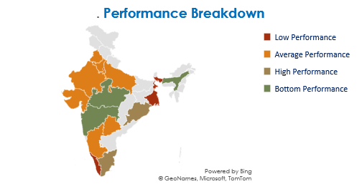

Slide 4
Key Insights from the Line Graph and Dashboard
Consistent High or Low Scores:
High Scores: Identify any regions or criteria that consistently show high average evaluation scores. This might indicate areas where practices are effective and should be continued or replicated.
Low Scores: Similarly, highlight regions with lower scores to address specific issues. For example, if a particular criterion like "Closure & Care" consistently scores low across regions, it could point to a common challenge that needs targeted interventions.
High Performer Percentage
Focus on regions with a high percentage of high performers. For instance, if your line graph shows a consistent trend of high performers in the North zone, it could indicate that the training or processes in place there are particularly effective.

Slide 5
Trends Over Time
Performance Fluctuations: Look for any noticeable trends or shifts in scores over time. For example, if the line graph shows a significant dip during a particular period, investigate what might have caused this. It could be due to external factors like increased workload or internal issues like changes in processes.
Stable Performance: If certain criteria or regions show stable high performance, this can indicate consistent practices that are working well.
Distribution of Performance Categories:
Analyze the distribution of performance categories (High, Average, Low, Bottom) to identify areas needing improvement. For instance, if a large percentage of evaluations fall into the "Average" category, it suggests that there is potential for improvement to elevate more scores to the "High" category.

Slide 6
Recommendations Based on Insights
Investigate Best Practices in High Performing Zones:
Explore the successful strategies and practices in regions with consistently high scores. Implement these practices in other regions to uplift their performance.
Targeted Training Programs:
Develop training programs focused on the evaluation criteria with lower scores. Tailor these programs to address specific weaknesses to help improve overall scores.
Monitor Trends and Take Action:
Use the line graph to monitor performance trends over time. Identify periods of significant change and investigate the causes. Proactively address these issues to stabilize performance.
Engage and Motivate:
Recognize and reward high performers to maintain their motivation. For lower performers, provide constructive feedback and additional support to help them improve.

Slide 7
Conclusion
Your dashboard is a valuable tool for visualizing and analyzing performance data. Leveraging these insights can help drive improvements and ensure consistent high performance across all zones and criteria.

